Slide 1
UNIT I – Hour V
FUNDAMENTALS OF SE AND REQUIREMENT ENGINEERING
Topic: Requirement Elicitation, Analysis, System Models

Slide 2
Overview of Software Requirements
Descriptions and specifications of a system and the process whereby they are derived.
Objectives
  To introduce the concepts of user and system requirements
  To describe functional and non-functional requirements
  To describe the principal requirements engineering activities
  To introduce techniques for requirements elicitation and analysis

Slide 3
Requirements engineering
The process of establishing the services that the customer requires from a system and the constraints under which it operates is developed.
The requirements themselves are the descriptions of the system services and constraints that are generated during the requirements engineering process
Requirements specify what the system is supposed to do, but not how the system is to accomplish its task.

Slide 4
What is a requirement?
It may span a wide range of statements
  a high-level abstract statement of a system service or system constraint
  a detailed mathematical functional specification
Types of requirements
  User requirements
  System requirements
  Software specifications – provide more (design) detail

Slide 5
User requirements
User requirements are defined using natural language, tables, and diagrams
Problems with natural language
  Precision vs. understandability
  Functional vs. non-functional requirements confusion
  Requirements amalgamation
Should describe functional and non-functional requirements so that they are understandable by system users who don’t have detailed technical knowledge

Slide 6
System requirements
More detailed specifications of user requirements
Serve as a basis for designing the system
May be used as part of the system contract
System requirements may be expressed using system models.

Slide 7
Definitions and specifications
R
e
q
u
i
r
e
m
e
n
t
s
d
e
f
i
n
i
t
i
o
n
1
.
T
h
e
s
o
f
t
w
a
r
e
m
u
s
t
p
r
o
v
i
d
e
a
m
e
a
n
s
o
f
r
e
p
r
e
s
e
n
t
i
n
g
a
n
d
1
.
a
c
c
e
s
s
i
n
g
e
x
t
e
r
n
a
l
f
i
l
e
s
c
r
e
a
t
e
d
b
y
o
t
h
e
r
t
o
o
l
s
.
R
e
q
u
i
r
e
m
e
n
t
s
s
p
e
c
i
f
i
c
a
t
i
o
n
1
.
1
T
h
e
u
s
e
r
s
h
o
u
l
d
b
e
p
r
o
v
i
d
e
d
w
i
t
h
f
a
c
i
l
i
t
i
e
s
t
o
d
e
f
i
n
e
t
h
e
t
y
p
e
o
f
1
.
2
e
x
t
e
r
n
a
l
f
i
l
e
s
.
1
.
2
E
a
c
h
e
x
t
e
r
n
a
l
f
i
l
e
t
y
p
e
m
a
y
h
a
v
e
a
n
a
s
s
o
c
i
a
t
e
d
t
o
o
l
w
h
i
c
h
m
a
y
b
e
1
.
2
a
p
p
l
i
e
d
t
o
t
h
e
f
i
l
e
.
1
.
3
E
a
c
h
e
x
t
e
r
n
a
l
f
i
l
e
t
y
p
e
m
a
y
b
e
r
e
p
r
e
s
e
n
t
e
d
a
s
a
s
p
e
c
i
f
i
c
i
c
o
n
o
n
1
.
2
t
h
e
u
s
e
r
’
s
d
i
s
p
l
a
y
.
1
.
4
F
a
c
i
l
i
t
i
e
s
s
h
o
u
l
d
b
e
p
r
o
v
i
d
e
d
f
o
r
t
h
e
i
c
o
n
r
e
p
r
e
s
e
n
t
i
n
g
a
n
1
.
2
e
x
t
e
r
n
a
l
f
i
l
e
t
y
p
e
t
o
b
e
d
e
f
i
n
e
d
b
y
t
h
e
u
s
e
r
.
1
.
5
W
h
e
n
a
u
s
e
r
s
e
l
e
c
t
s
a
n
i
c
o
n
r
e
p
r
e
s
e
n
t
i
n
g
a
n
e
x
t
e
r
n
a
l
f
i
l
e
,
t
h
e
1
.
2
e
f
f
e
c
t
o
f
t
h
a
t
s
e
l
e
c
t
i
o
n
i
s
t
o
a
p
p
l
y
t
h
e
t
o
o
l
a
s
s
o
c
i
a
t
e
d
w
i
t
h
t
h
e
t
y
p
e
o
f
1
.
2
t
h
e
e
x
t
e
r
n
a
l
f
i
l
e
t
o
t
h
e
f
i
l
e
r
e
p
r
e
s
e
n
t
e
d
b
y
t
h
e
s
e
l
e
c
t
e
d
i
c
o
n
.

Slide 8
Functional and non-functional requirements
Functional requirements
  Statements of services the system should provide, how the system should react to particular inputs and how the system should behave in particular situations.
Non-functional requirements
  constraints on which the services or functions offered by the system such as timing constraints, constraints on the development process, standards, etc.
Domain requirements
  Requirements that come from the application domain of the system and that reflect characteristics of that domain

Slide 9
Examples of functional requirements
The user shall be able to search either all of the initial set of databases or select a subset from it.
The system shall provide appropriate viewers for the user to read documents in the document store.
Every order shall be allocated a unique identifier (ORDER_ID) which the user shall be able to copy to the account’s permanent storage area.

Slide 10
Requirements precision, completeness, and consistency
The principle requirements should be precise, complete, and consistent
Precise
  They should state exactly what is desired from the system
Complete
  They should include descriptions of all facilities required from the system
Consistent
  There should be no conflicts or contradictions in the descriptions of the system facilities
In practice, it is very difficult to produce a complete and consistent requirements document

Slide 11
Ambiguous/imprecise requirement
4.A.5 The database shall only support the generation and control of configuration objects; that is, objects which are themselves groupings of other objects in the database. The configuration control facilities shall allow access to the objects in a version group by the use of an incomplete name.
What about non-configuration objects?
(Only configuration object is mentioned)
What about other database functionality?
(Apart data access functionality such as add, delete, modify)
What about level of service other than support?
(Like data integrity, data security, data availability)
Something else?
………………………

Slide 12
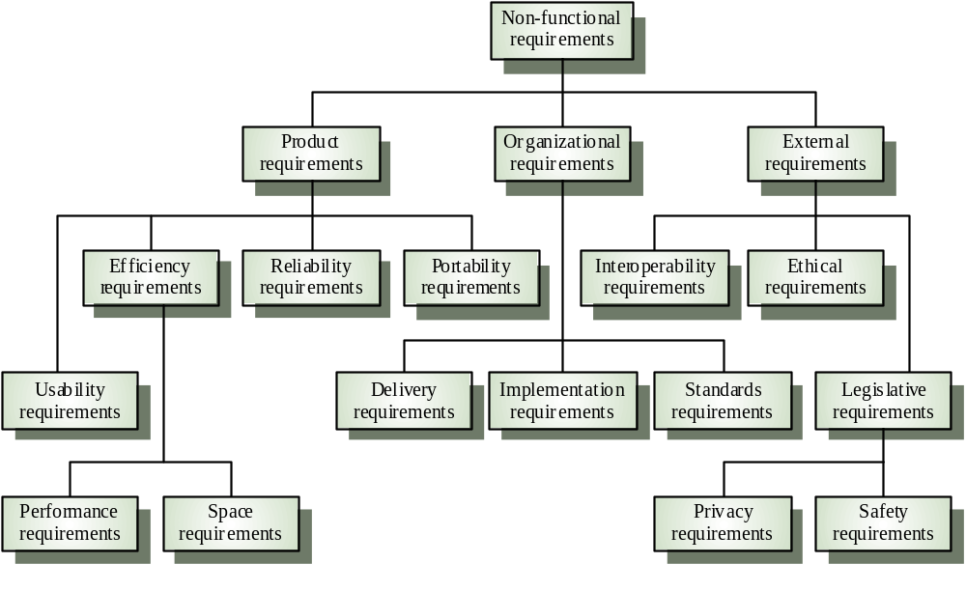
Non-functional requirement types

Slide 13
Non-functional requirements examples
Product requirement
  It shall be possible for all necessary communication between the APSE (Ada Programming Support Environment) and the user to be expressed in the standard Ada character set
Organisational requirement
  The system development process and deliverable documents shall conform to the process and deliverables defined in XYZCo-SP-STAN-95
External requirement
  The system shall not disclose any personal information about customers apart from their name and reference number to the operators of the system

Slide 14
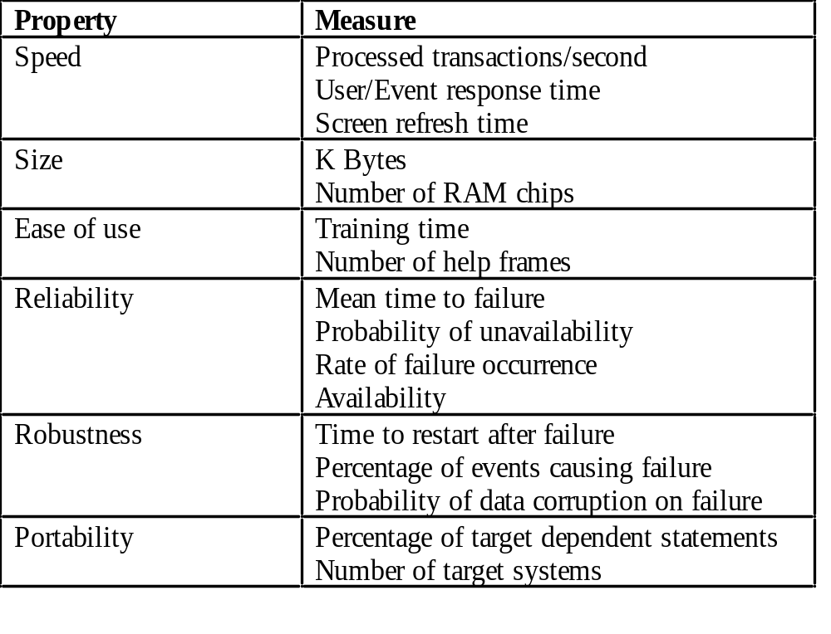
Non-functional requirements measures

Slide 15
Requirements interaction
Conflicts between different non-functional requirements are common in complex systems
Spacecraft system
  To minimise weight, the number of separate chips in the system should be minimised
  To minimise power consumption, lower power chips should be used
  But, using low power chips may mean that more chips have to be used
  Which is the most critical requirement?

Slide 16
Domain Requirement:
Train protection system
The deceleration of the train shall be computed as:
  D_{train} = D_{control} + D_{gradient}
where D_{gradient} is 9.81ms² * compensated gradient/alpha and where the
values of 9.81ms² /alpha are known for different types of train.
Problems
  Understandability
    Requirements are expressed in the language of the application domain
    This is often not understood by software engineers
  Implicitness
    Domain specialists understand the area so well. So they do not think of making the domain requirements explicit

Slide 17
Requirements document
Specify external system behaviour
Specify implementation constraints
Easy to change
Serve as reference tool for maintenance
Record forethought about the life cycle of the system
  i.e. predict changes
Characterise responses to unexpected events

Slide 18
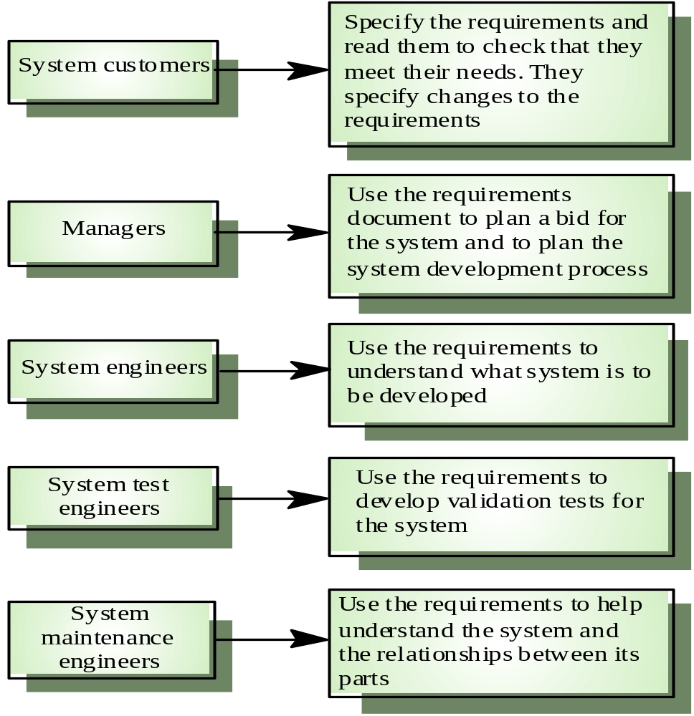
Users of a requirements document

Slide 19
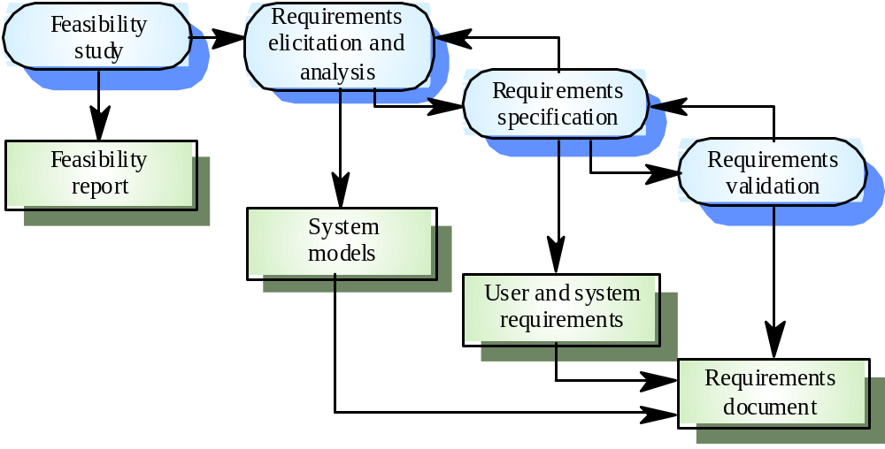
Requirements engineering process

Slide 20
Feasibility studies
A feasibility study decides whether or not the proposed system is worthwhile
A short focused study that checks
  If the system contributes to organisational objectives
  If the system can be engineered using current technology and within budget
  If the system can be integrated with other systems that are used

Slide 21
Elicitation and analysis
Sometimes called requirements elicitation or requirements discovery
Involves technical staff working with customers to find out
  the application domain requirements
  the exact services that the system should provide
  the system’s operational constraints
May involve end-users, managers, engineers involved in maintenance, domain experts, trade unions, etc.
  These are called stakeholders

Slide 22
Problems of requirements analysis
Stakeholders don’t know what they really want
Stakeholders express requirements in their own terms.
Different stakeholders may have conflicting requirements.
Organisational and political factors may influence the system requirements.
The requirements may change during the analysis process.
  New stakeholders may emerge and the business environment change

Slide 23
Requirements Specifications
Establishing all functional and functional requirements of the system.
The specification should be in proper format as recommended by the organization.
The system specifications is the basis for the system modelling.
System modelling should be done to prove that the user and system requirements identified is meeting the customer’s needs.

Slide 24
Requirements validation
Concerned with demonstrating that the requirements defines the system is the customer really wants.
Requirements error costs are high, so validation is very important
  Fixing a requirements error after delivery may cost up to 100 times more than the cost of fixing an implementation error.
Requirements checking
  Validity
  Consistency
  Completeness
  Realism
  Verifiability

Slide 25
Requirements validation techniques
Reviews
  Systematic manual analysis of the requirements.
Prototyping
  Using an executable model of the system to check requirements.
Test-case generation
  Developing tests for requirements to check testability
Automated consistency analysis
  Checking the consistency of a structured requirements description

